Slide 1
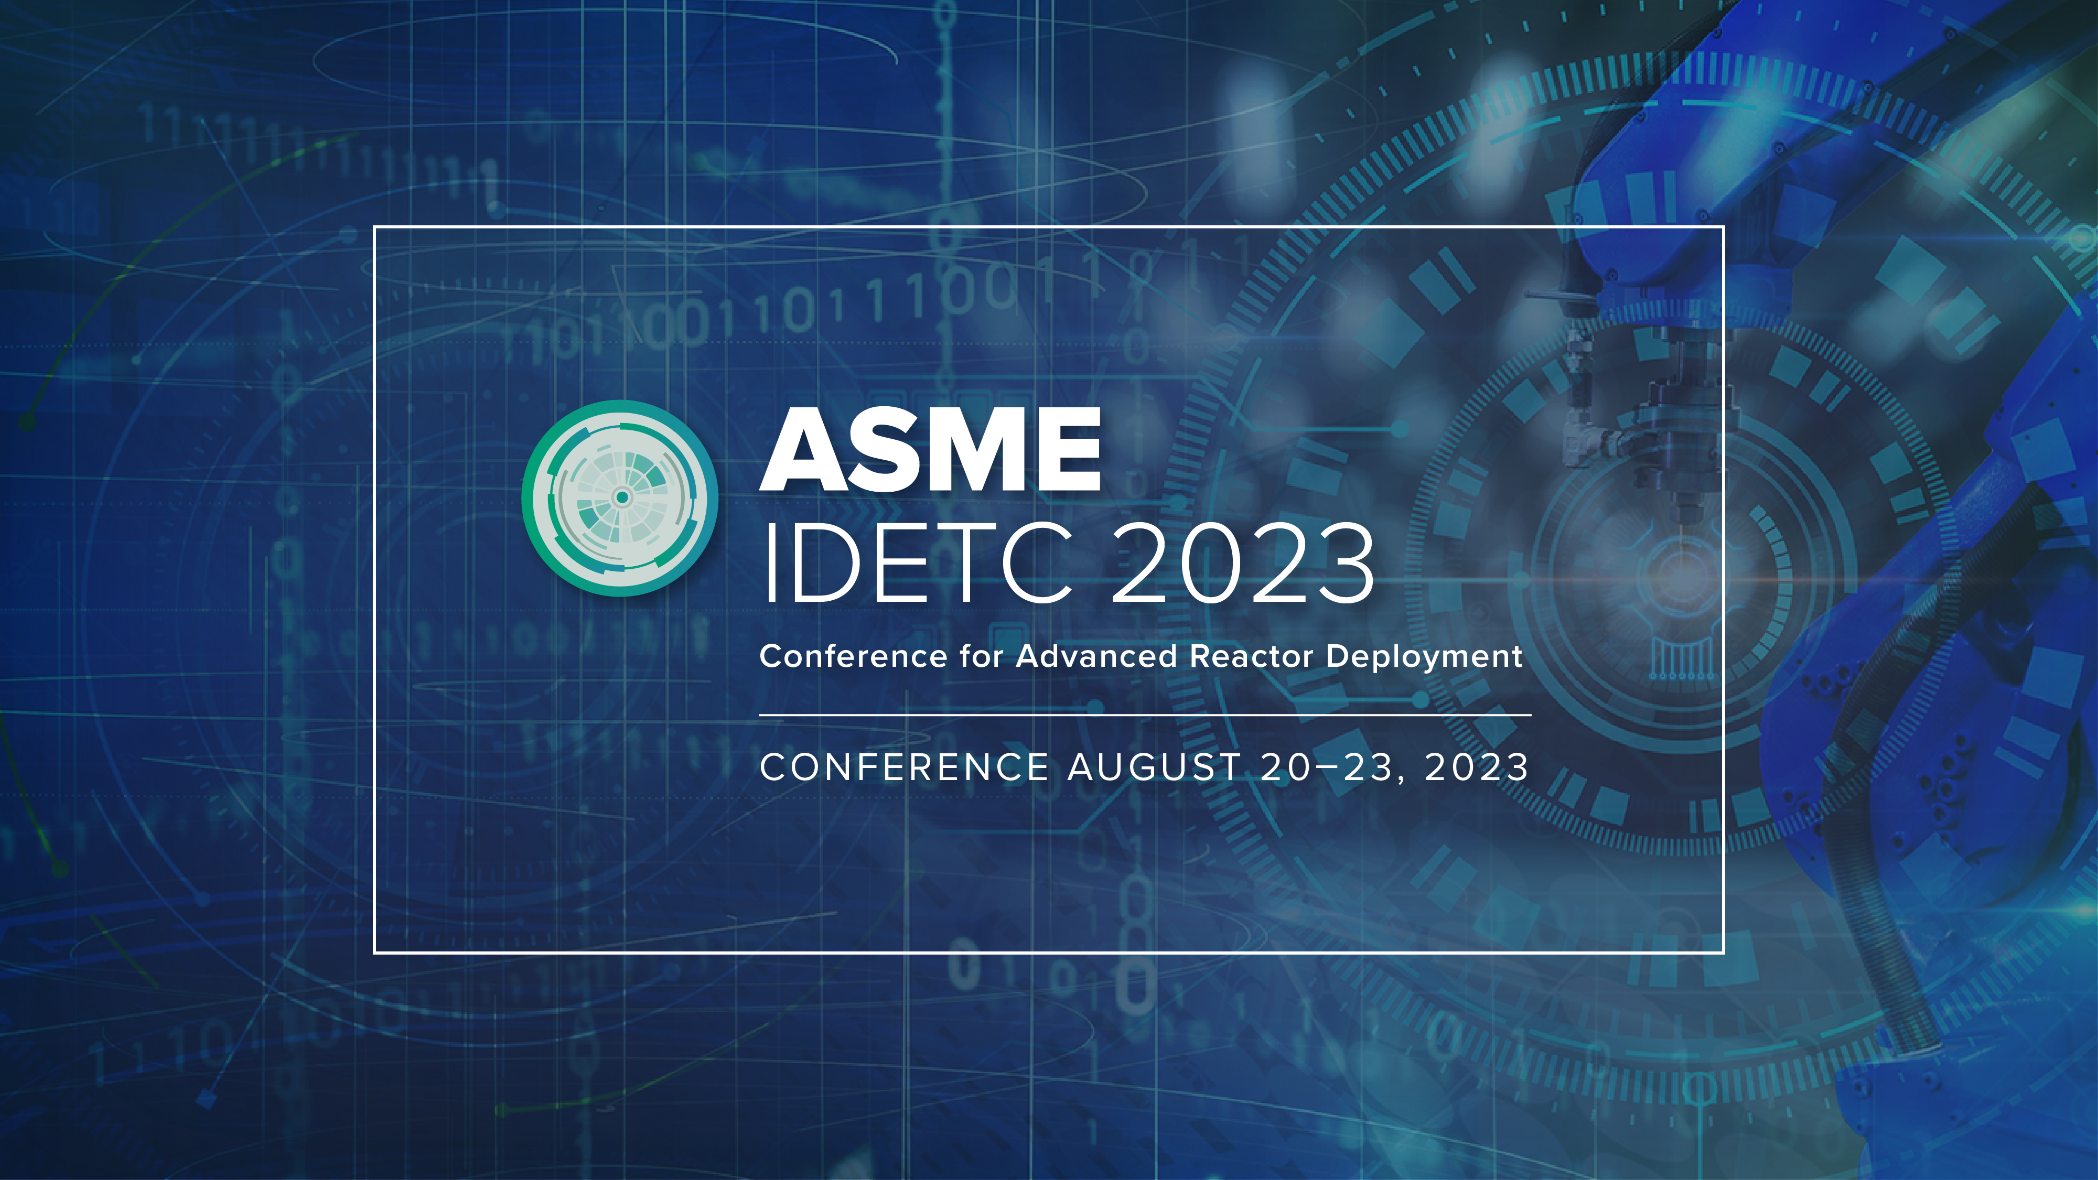
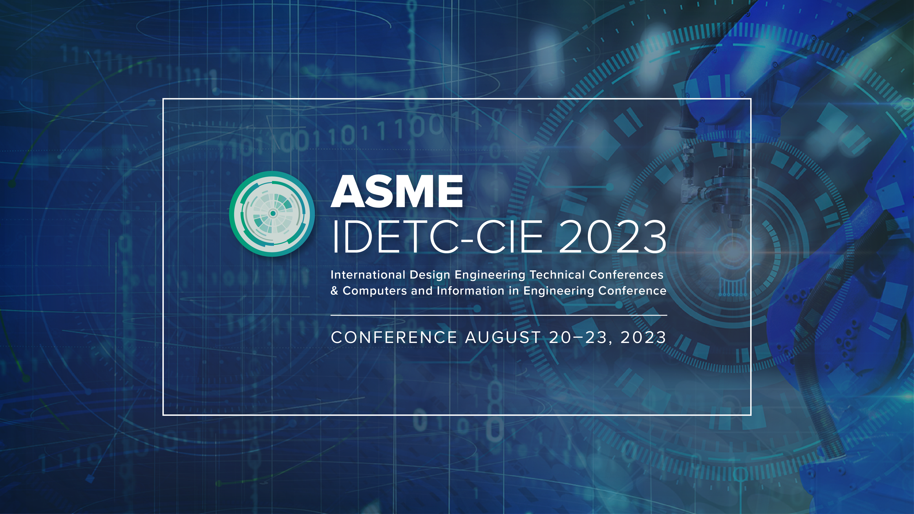
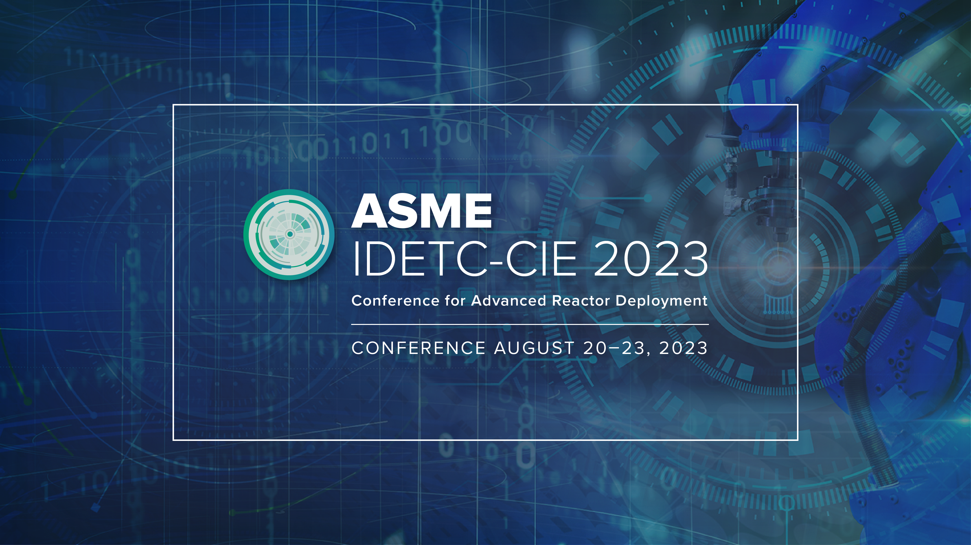

Slide 2


Automating Material Selection for Product Design
Team: ADML Mavericks
Team Members: Mutahar Safdar, Jiarui Xie
2023 IDETC Hackathon
20-08-2023

Slide 3
Outline
Introduction
Problem Statement
Dataset
Methodology
Overall Framework
Textual Design Features
Numeric Design Features
Graphic Design Features
3D Design Features
Feature Fusion
Integrating Rule-based selection with feature-based predictions
Results
Tree-based Ensemble for Multi-Class classification
Discussion and Future Works
Challenges
Future Works
3/18

Slide 4
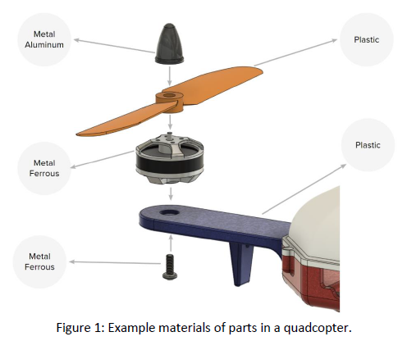
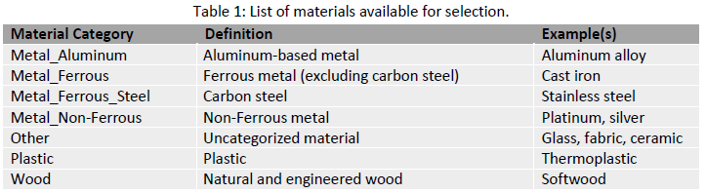
Introduction: problem statement
In this challenge, our task is to come up with an open-ended solution to identify an appropriate material for a set of parts, based on their CAD geometries and assembly context.
4/18

Slide 5
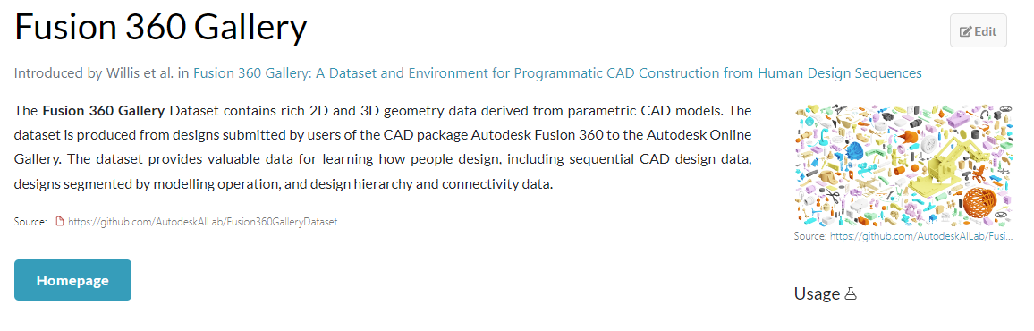
Introduction: dataset
The challenge is based on Fusion 360 Gallery dataset. To support this challenge, we are provided with a dataset of 6346 assemblies with a total of 131,403 parts, each of which has a material label (10 of those assemblies will be kept for the test set). Although the design goals or constraints that the designer was accounting for while creating these assemblies were not clear, these material labels in this dataset can be treated as ‘ground truth’ labels.
https://paperswithcode.com/dataset/fusion-360-gallery
5/18

Slide 6
Introduction: dataset
Fusion 360 Gallery Dataset Train (6336 Assemblies):
----------
STEP files (Assembly and Part Bodies)
----------
SMT Files (Assembly and Part Bodies)
----------
OBJ Files (Assembly and Part Bodies)
----------
Jason File (Mixed Features)
----------------------------
----------
PNG Files (Assembly and Part Bodies)
----------
AM Concern (AM_C): Characteristic of Concern
Fusion 360 Gallery Dataset Test (10 Assemblies) :
----------
Same files as train dataset
----------
Except the ground truth information
---------
6/18

Slide 7
Methodology: overall framework
Textual Data (e.g., name, industry, component)
Data-driven
Available Information
Feature Extraction
Numeric Data (e.g., Dimensions)
Multi-class Classification
Graphic Data (e.g., images)
Data Analysis
3D or Geometric Data (e.g., part and assembly design files)
Dataset
Final Prediction
Missing Information
Expert Knowledge
Design Rationale
Sustainability
Feasibility
….
Rule or Criteria Creation
Majority voting based on cost, neighbors, sustainability …
Knowledge-driven
7/18

Slide 8
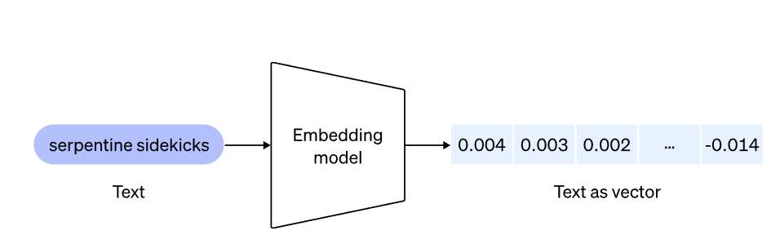
Methodology: textual design features
The analysis of the assembly.json file highlights that there is explicit text describing different aspect of the bodies.
It may be useful to convert them into an embedding of a large space where relative relations can be exploited in a downstream classifier.
We used openai’s second generation embedding model to generate a vector of 1536 dimension by concatinating this textual information.
body_name
Categories
Industries
component_name
occurrence_name
1536 dimensional embedding vector
https://openai.com/blog/new-and-improved-embedding-model
8/18

Slide 9
Methodology: numeric design features
The analysis of the assembly.json file highlights that there are important numeric features highlighting part and assembly information
We selected areas and volumes and whether a part was grounded or not.
We decided to keep them in original values without any processing when fed to the downstream model to highlight relative variations.
9/18

Slide 10
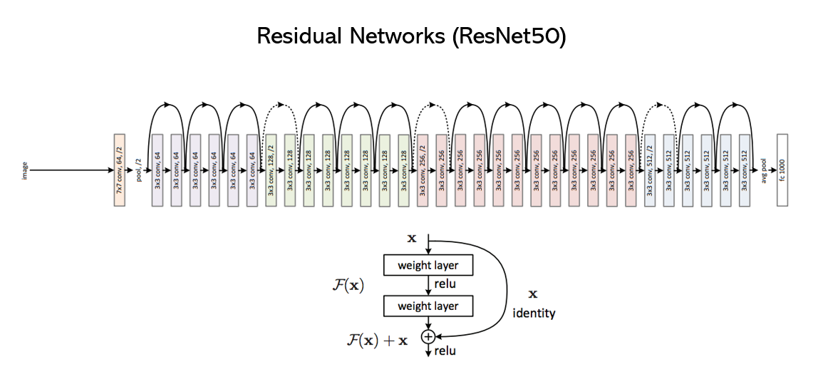
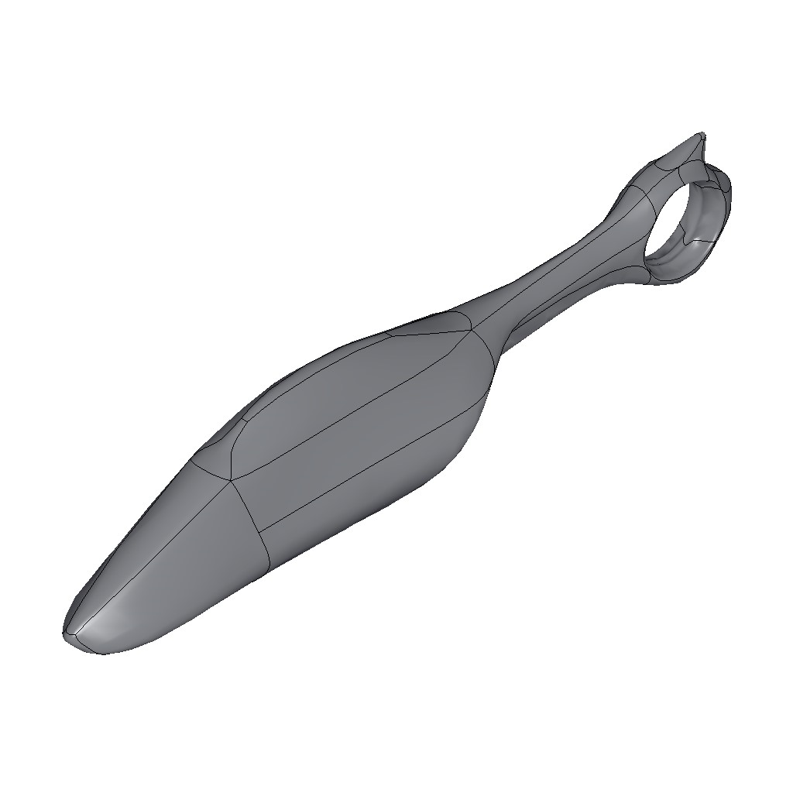
Methodology: graphic design features
The dataset provides images for all parts in the assemblies.
This information is less expensive to extract as compared to 3D or geometric data.
We used ResNet-50 to extract features from its fully connected layer (dimension 1000) by passing the individual images in the evaluation mode.
1000-dimensional vector from fully connected layer
10/18

Slide 11
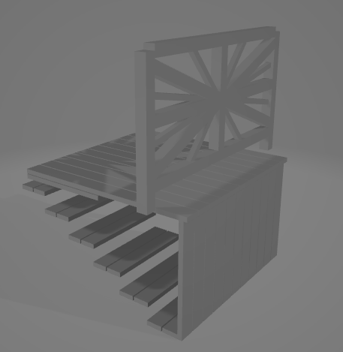
Methodology: geometric design features
3D representation of the models can have important information which could assist the prediction task.
We proposed to generate voxels or meshes of each part geometry to extract 3D features from a Geometric DL model or a 3D CNN.
These features can either be used directly with the previous features or be used to act as node values in a graph neural network to provide further assembly context.
Implicit part features
Part Features with consideration of assembly context
Geometric Feature Extraction
Graph Neural Network
11/18

Slide 12
Methodology: geometric design features
3D representation of the models can have important information which could assist the prediction task.
We proposed to generate voxels or meshes of each part geometry to extract 3D features from a Geometric DL model or a 3D CNN.
These features can either be used directly with the previous features or be used to act as node values in a graph neural network to provide further assembly context.
Implicit part features
Part Features with consideration of assembly context
Geometric Feature Extraction
Graph Neural Network
12/18

Slide 13
Methodology: fusing features
Text embeddings
Graphic Features
Single part-level feature vector
Shallow or deep model
Insights
Numeric Features
Geometric Features
13/18

Slide 14
Methodology: Knowledge guided
We propose to pivot to ensemble-based prediction where we use expert knowledge to select material from different predictions
We can bring cost, sustainability, and use predictions of other parts to inform the material selection for the current part
This is planned as the next step of our methodology
14/18

Slide 15
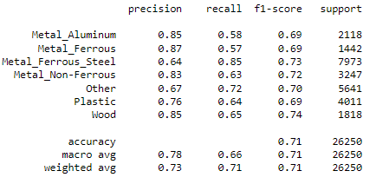
Results
15/18

Slide 16
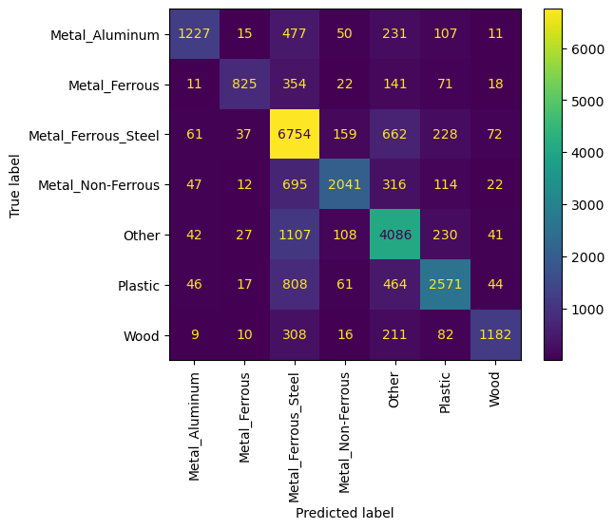
Results
16/18

Slide 17
Discussion and Future Works
Better results can be obtained by integrating geometric features
Domain knowledge can be used to pick one final material candidate from a set of predictions
The current approach may be expensive computationally and simpler solutions may be evaluated.
17/18

Slide 18
Q/A
Thanks for your kind attention!
mutahar.safdar@mail.mcgill.ca
18/18

